Slide 1
Containers
CS 208, Winter 2025
Class 4
K. K. Ramakrishnan

Slide 2
Virtual Appliances & Multi-Core
Virtual appliance: pre-configured VM with OS/ apps pre-installed
Just download and run (no need to install/configure)
Software distribution using appliances
(see: “SnowFlock: Rapid Virtual Machine Cloning for Cloud Computing”, H. Andrés Lagar-Cavilla et. al., Eurosys 2009)
Multi-core CPUs
Run multiple VMs on multi-core systems
Each VM assigned one or more vCPU
Mapping from vCPUs to physical CPUs
Today: Virtual appliances have evolved into Docker containers

Slide 3
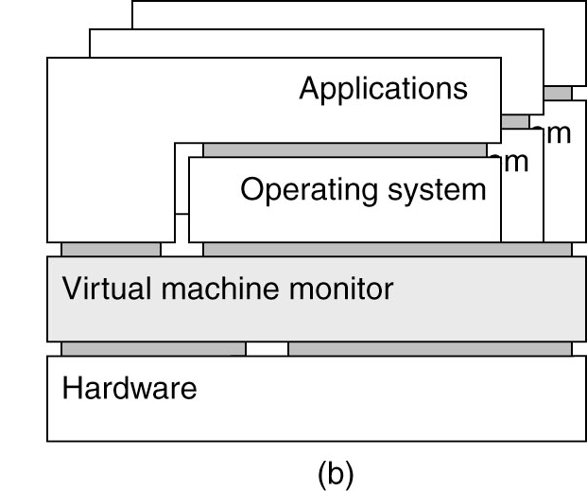
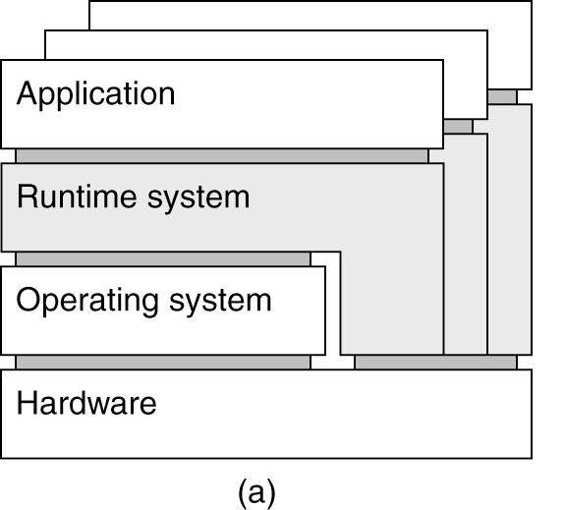
Examples
Application-level virtualization: “process virtual machine”
In contrast to VMM /hypervisor

Slide 4
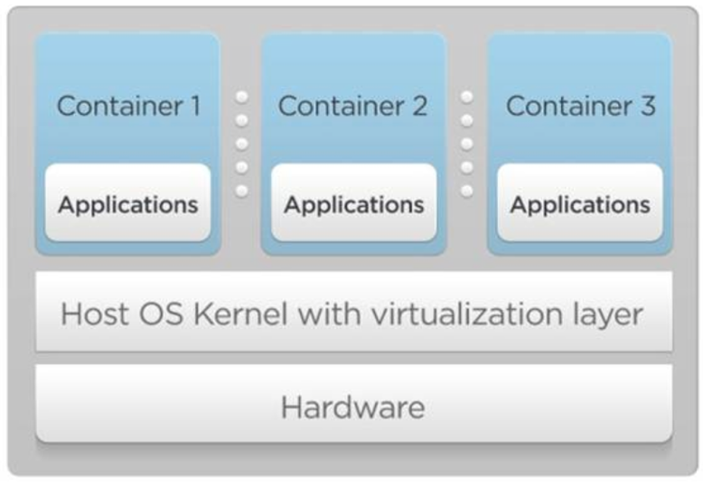
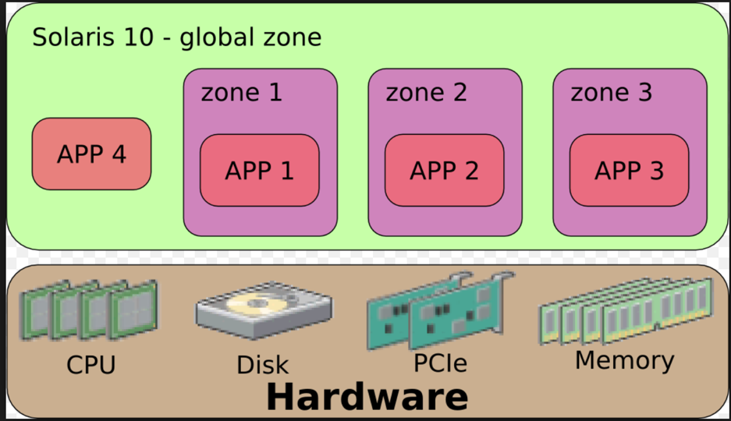
OS Virtualization
Emulate OS-level interface with native interface
“Lightweight” virtual machines
No hypervisor, OS provides necessary support
Referred to as containers
Solaris containers, BSD jails, Linux containers

Slide 5
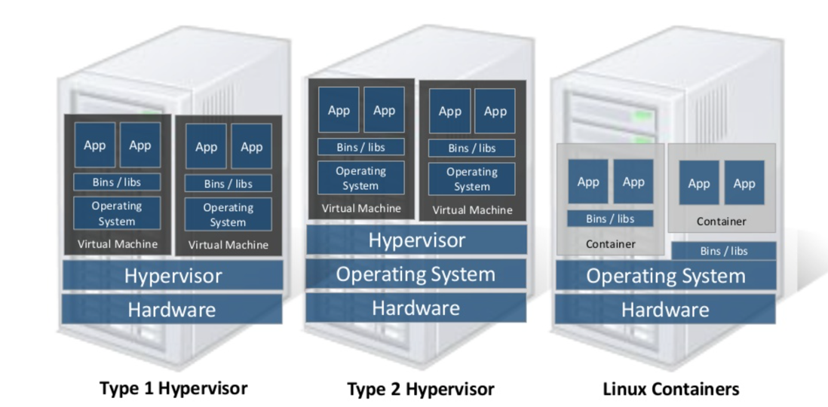
Linux Containers (LXC)
Containers share OS kernel of the host
OS provides resource isolation
Benefits
Fast provisioning, bare-metal like performance, lightweight
Material courtesy of “Realizing Linux Containers” by Boden Russell, IBM

Slide 6
OS Mechanisms for LXC
OS mechanisms for resource isolation and management
namespaces: process-based resource isolation
Cgroups: limits, prioritization, accounting, control
chroot: apparent root directory (Unix operation that changes the apparent root directory for the current running process and children)
Linux security module, access control
Tools (e.g., docker) for easy management

Slide 7
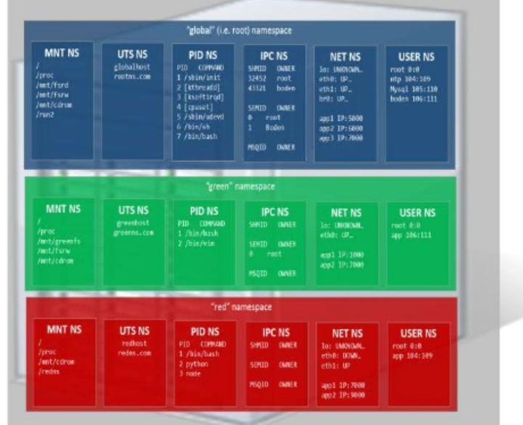
Linux Namespaces
Namespace: restrict what a container can see
Provide process level isolation of global resources
Processes have illusion they are the only processes in the system
MNT: mount points, file systems (what files, dir are visible)?
PID: what other processes are visible?
NET: NICs, routing
Users: what uid, gid are visible?
chroot: change root directory
program run in such a modified environment cannot name (and normally can’t access) files outside designated directory tree.
Root name space
Green name space
Red name space

Slide 8
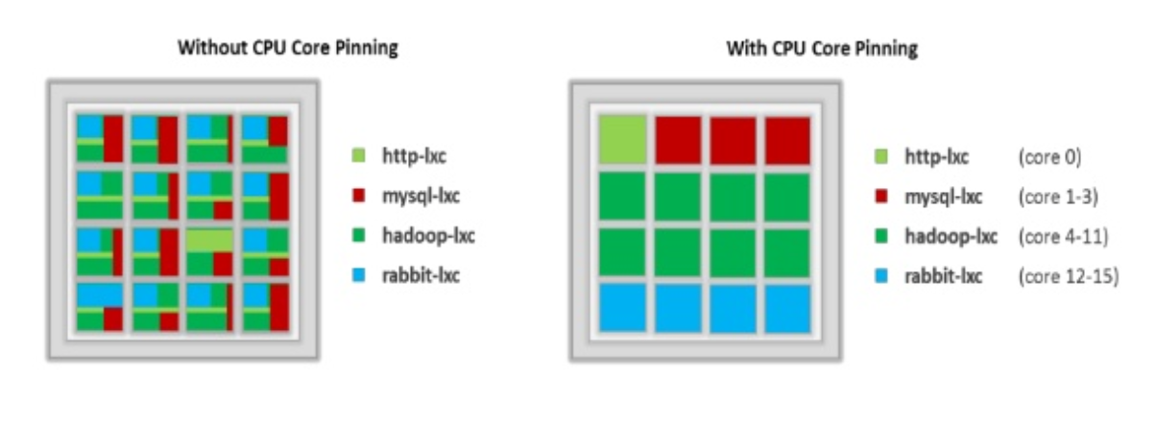
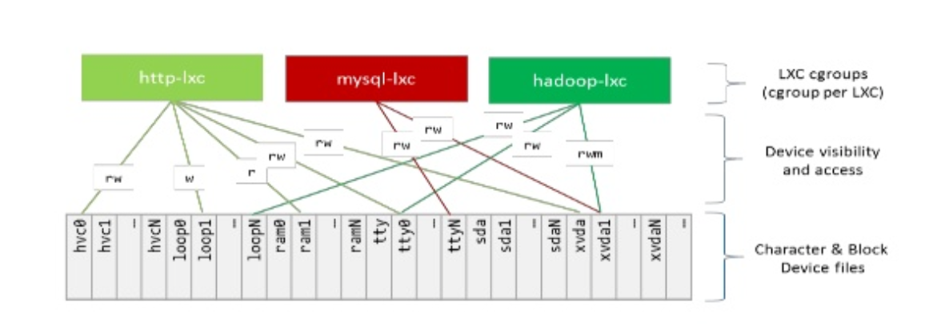
Linux cgroups
Resource isolation
what and how much can a container use?
Set upper bounds (limits) on resources that can be used
Fair sharing of certain resources
Examples:
cpu: weighted proportional share of CPU for a group
cpuset: cores that a group can access
block io: weighted proportional block IO access
memory: max memory limit for a group

Slide 9
Proportional Share Scheduling
Linux cgroups
Uses a variant of proportional-share scheduling
Share-based scheduling:
Assign each process a weight w_i (a “share”)
Allocation is in proportion to share
fairness: allow reuse of unused cycles by others in proportion to weight
Examples: fair queuing, start time fair queuing
Hard limits: assign upper bounds (e.g., 30%), no reallocation
Credit-based: allocate credits every time T, can accumulate credits, and can burst up-to credit limit
can a process starve other processes?

Slide 10
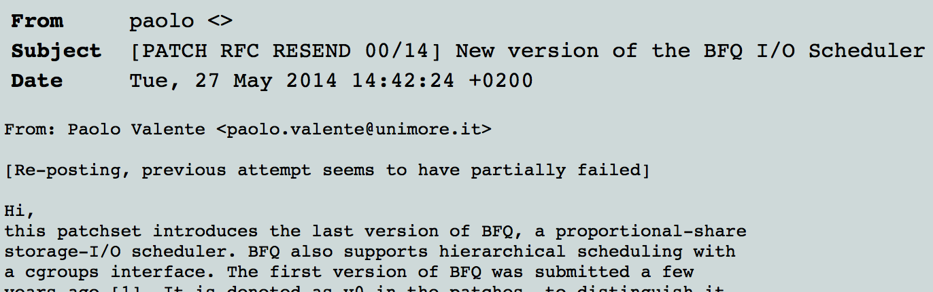
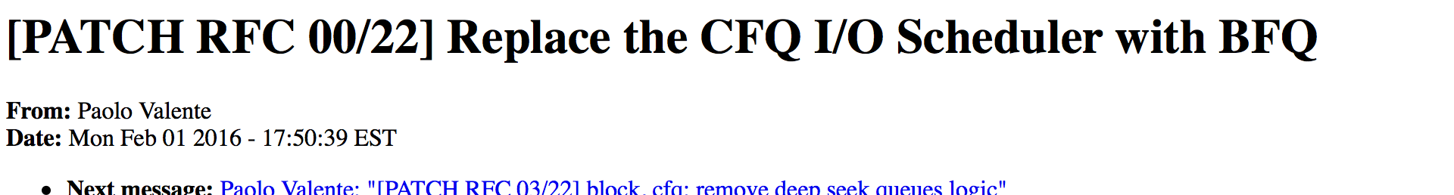
Share-based Schedulers
Budget Fair Queueing:
BFQ is a proportional-share storage-I/O scheduler that also supports cgroups.

Slide 11
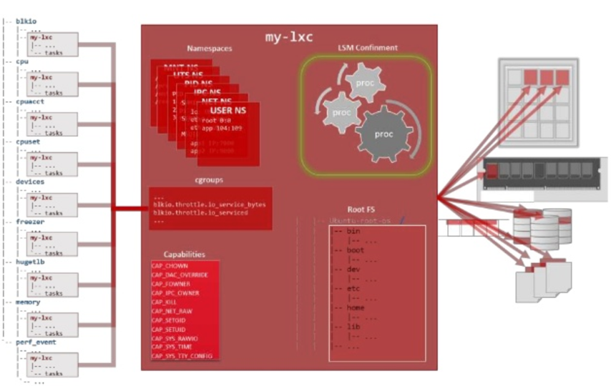
Putting it all together
Images: files/data for a container
can run different distributions/apps on a host
Linux security modules and access control
Linux capabilities: per process privileges

Slide 12
Docker and Linux Containers
Linux containers are a set of kernel features
Need user space tools to manage containers
Virtuoze, OpenVZm, VServer,Lxc-tools, Wardenm Docker
What does Docker add to Linux containers?
Portable container deployment across machines
Application-centric: geared for app deployment
Automatic builds: create containers from build files
Component re-use
Docker containers are self-contained: no dependencies

Slide 13
Docker and Containers
Docker is light-weight and portable
Minimal overhead (cpu/io/network)
Based on Linux containers
Can run on any Linux system that supports LXC.
Self-sufficient
A Docker container contains everything it needs to run
Minimal Base OS
Libraries and frameworks provide customization

Slide 14
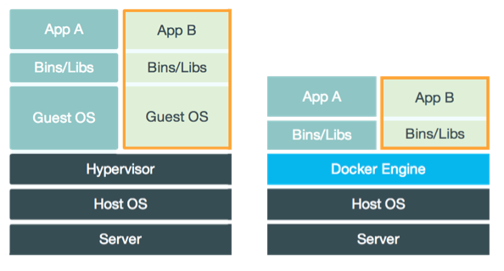
VMs vs. Containers
Easy to build, run & share containers
Better performance vs. VMs
Reduces complexity of dynamically instantiating functions

Slide 15
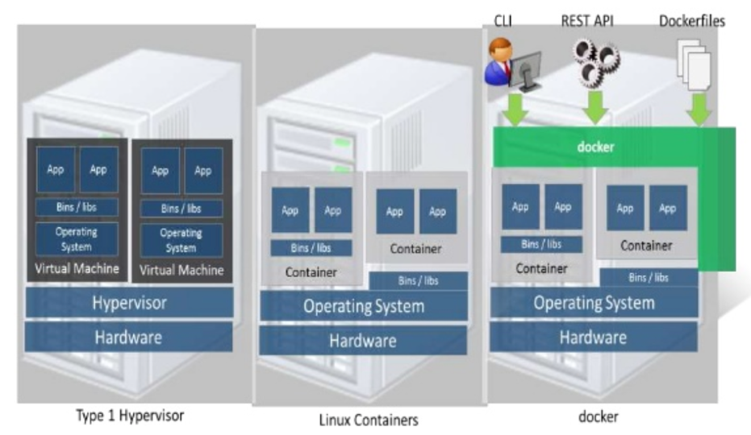
Docker
Docker uses Linux containers

Slide 16
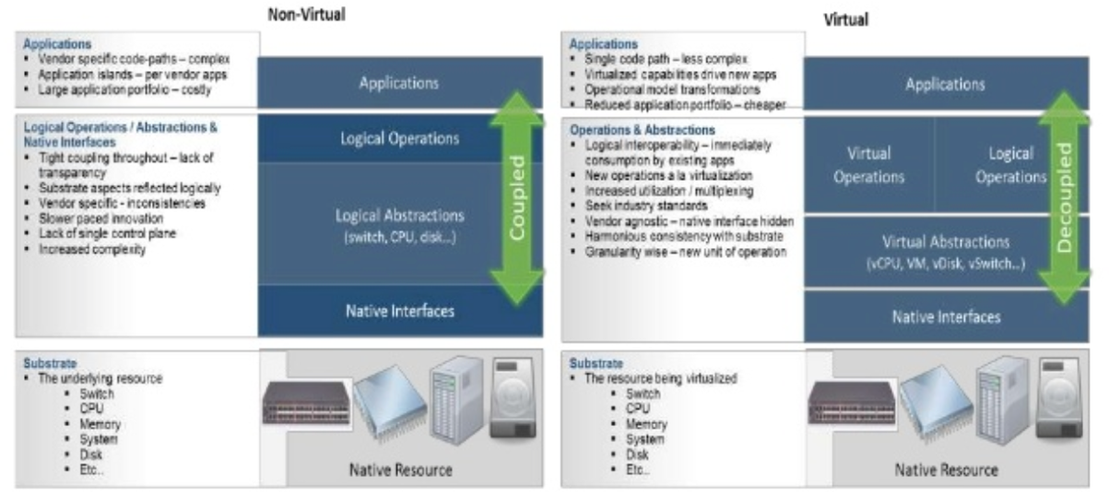
LXC Virtualization Using Docker
Portable: docker images run anywhere docker runs
Docker decouples LXC provider from operations
uses virtual resources (LXC virtualization)
fair share of physical NIC vs use virtual NICs that are fair-shared

Slide 17
Docker Images and Use
Docker uses a union file system (AuFS)
allows containers to use host FS safely
Essentially a copy-on-write file system
read-only files shared (e.g., share glibc)
make a copy upon write
Allows for small efficient container images
Docker Use Cases
“Run once, deploy anywhere”
Images can be pulled/pushed to repository
Containers can be a single process (useful for microservices) or a full OS

Slide 18
Use of Virtualization Today
Data centers:
server consolidation: pack multiple virtual servers onto a smaller number of physical servers
saves hardware costs, power and cooling costs
Cloud computing: rent virtual servers
cloud provider controls physical machines and mapping of virtual servers to physical hosts
User gets root access on virtual server
Desktop computing:
Multi-platform software development
Testing machines
Run apps from another platform

Slide 19
Stages of Docker Containers

Slide 20
Terminology
Docker Image
In plain terms, an image is a snapshot of Docker container (can’t change)
Docker Container
Once the image is uploaded to an image registry (Docker Hub), it can be pulled by users
When an image is pulled and “run” it becomes a container
Very similar to cloning a repository from github and running it on your machine
The work you do will not affect the state of the image on the registry

Slide 21
Creating an Image
Best Practice for creating an image is to use a Dockerfile
A Dockerfile is a manifest with command line entries that can convert your code into an image
In this manifest, you describe the packages and libraries to install for container startup
Dockerfile also holds the path of the scripts that will be included in the container
After the file is properly constructed, a “docker build” command will create an image with the contents provided in the manifest

Slide 22
Inside of a Dockerfile
Dockerfile use the command tags in red
The FROM is pulling the python2.7 image from Docker Hub and using it as a launch pad for the rest of your image
The COPY tag specifies a file or directory to copy over to the container; t
Then it is started
The RUN tag is used for specifying commands that the container will have to use to create a workable environment for your code to run
In this example, the code will utilize the pymemcache and pandas libraries
The RUN tags will install the respective packages for these libraries
There is also a CMD tag that will initiate your script. So in this case include python memserv.py next to CMD
Dockerfile.yml
FROM python:2.7
COPY memserv.py /usr/src/
COPY test_data.csv /usr/src/
RUN pip install pymemcache
RUN pip install pandas
CMD ["python", "memserv.py"]

Slide 23
Creating an Image Cont’d
After your Dockerfile has been properly set up to your needs, it is time to build
$docker build -t <img_name> .
“.” here states that the Dockerfile is in the current working directory. Because docker looks for a file titled “Dockerfile.yml”, only one should be included in the directory. You can specify the path to a certain Dockerfile with -f instead of using “.”
Run the command $docker images to see if your image was created successfully
REPOSITORY TAG IMAGE ID CREATED SIZE
memserv latest c31677a6c7d8 47 seconds ago 1.03GB
python 2.7 b707c2244b7d 2 weeks ago 886MB

Slide 24
Docker Hub
Docker Hub: A cloud-based repository in which Docker users and partners create, test, store and distribute container images.
Docker Hub: a user can access public, open source image repositories & space to create own private repositories.
Image repositories: spaces within Docker Hub - users upload and store container images.
Public repositories: enable users share & collaborate on container images.
Private repositories protect any sensitive or proprietary data
Docker users can opt for Docker Registry: a stateless, open source server-side application
Can maintain the storage and distribution of Docker images in private company repository instead of relying on Docker’s cloud service.

Slide 25
Pushing Image to a Registry
Making an account with Docker Hub is necessary for the next steps
Once the Image is ready, we can push this image onto the registry
Think of pushing your code to github, making your code mobile
This is necessary when using images for Kubernetes pod, deployments, and services
First log into your Docker Hub account
$docker login --username=<username>
Enter password
Then tag the image to keep track of the version
$docker tag <img_id> <account_name/img_name:tag>
Then Push
$docker push <account_name/img_name>
User pulls an image from Docker Hub with the docker pull command

Slide 26
Creating a Container
As mentioned before, a container is created when a run command is performed on an image
In an earlier slide we saw that $docker image gives us information about our images
We use the image ID provided to specify what image to run
$ docker run -it -d --network=<net_name> c31677a6c7d8
-it allocates a tty for the container process
-d runs the process in detached mode
--network specifies what network the container should attach to
Running $docker ps -a will give you all docker containers currently running
CONTAINER ID IMAGE COMMAND CREATED STATUS PORTS NAMES
ac4354485aa4 c31677a6c7d8 "python2" 5 seconds ago Up 3 seconds clever_banzai

Slide 27
Interacting with a Container
If a CMD tag was not specified in the Dockerfile, we have to go into the container and start the script in there
$docker exec -it <ac4354485aa4> bash will allow you to run arbitrary commands inside of the container
Once you “get into” the container, all of the files you specified to copy over should be in /usr/src/
root@node0:/users/hsiez001/docker_mem/server_side# docker exec -it ac4354485aa4 bash
root@ac4354485aa4:/# cd /usr/src/
root@ac4354485aa4:/usr/src# ls
memserv.py test_data.csv
From here you can run $python memserv.py

Slide 28
VMs, Unikernels and Containers: Experiences on the Performance of Virtualization Technologies
Felipe Huici, Filipe Manco, Jose Mendes, Simon Kuenzer NEC Europe Ltd. (Heidelberg)

Slide 29



In the Beginning…
VM

Slide 30
In the Beginning…
“Tinyﬁed VMs”
VM

Slide 31
In the Beginning…
“Tinyﬁed VMs”
VM
unikernels

Slide 32
In the Beginning…
“Tinyﬁed VMs”
containers
VM
unikernels

Slide 33
In the Beginning…
“Tinyﬁed VMs”
containers
VM
unikernels

Slide 34
Virt. Technology Benchmarking
Metrics:
VM Image and memory consumption
VM creation time
Delay
Throughput

Slide 35


Virt. Technology Benchmarking
Metrics:
VM Image and memory consumption
VM creation time
Delay
Throughput
higher overhead
lower overhead

Slide 36
Virt. Technology Benchmarking
Metrics:
VM Image and memory consumption
VM creation time
Delay
Throughput
higher overhead
lower overhead

Slide 37
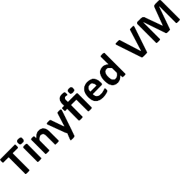
Virt. Technology Benchmarking
Metrics:
VM Image and memory consumption
VM creation time
Delay
Throughput
higher overhead
lower overhead

Slide 38
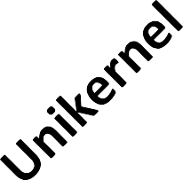
Virt. Technology Benchmarking
Metrics:
VM Image and memory consumption
VM creation time
Delay
Throughput
higher overhead
lower overhead

Slide 39
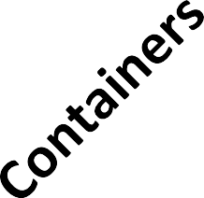

Virt. Technology Benchmarking
Metrics:
VM Image and memory consumption
VM creation time
Delay
Throughput
higher overhead
lower overhead

Slide 40
Virt. Technology Benchmarking
Metrics:
VM Image and memory consumption
VM creation time
Delay
– Throughput
?
higher overhead
lower overhead

Slide 41

Virt. Technology Benchmarking
Metrics:
VM Image and memory consumption
VM creation time
Delay
Throughput
higher overhead
lower overhead

Slide 42

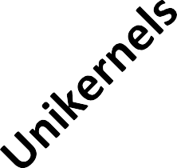
Virt. Technology Benchmarking
Metrics:
VM Image and memory consumption
VM creation time
Delay
Throughput
?
higher overhead
lower overhead

Slide 43
Virtualization Technology Benchmarking
Metrics:
VM image and memory consumption: ls, top, xl
VM creation time: SYN ﬂood + RST detection
Throughput: iperf, guest to host (TCP traﬃc)
RTT: ping ﬂood
VM-based tests run on both Xen and KVM
Hardware: x86_64 server with an Intel Xeon E5-1630 v3 3.7GHz CPU (4 cores), 32GB RAM.

Slide 44
Virtualization Technologies
“Standard” VM
Standard Debian-based Linux VM
“Tinyﬁed” VM
Tinyx, based on Linux kernel/busybox
Unikernel
On Xen: MiniOS + miniperf
On KVM: OSv + iperf
Containers
Docker

Slide 45

Virtualization Technologies
“Standard” VM
– Standard Debian-based Linux VM
“Tinyﬁed” VM
– Tinyx, based on Linux kernel/busybox
Unikernel
On Xen: MiniOS + miniperf
On KVM: OSv + iperf
Containers
Docker

Slide 46


Standard VM: Application on Top of Distro
User Application
3rd Party Applications
Libraries
Services
Kernel

Slide 47

Most of the VM not Used…
Nginx
User Application
memcached
bash
3rd Party Applications
libssl
libc
Libraries
init
ssh
Services
ext4
netfront
blkfront
Kernel

Slide 48
Tinyx: Keep Only What’s Needed
Nginx
User Application
memcached
bash
3rd Party Applications
libssl
Libraries
libc
ssh
init
Services
ext4
netfront
blkfront
Kernel

Slide 49



Tinyx: Taylor-made Distro
Nginx
User Application
memcached
bash
3rd Party Applications
libssl libc
Libraries
ssh init
Services
netfront
blkfront
ext4
Kernel

Slide 50
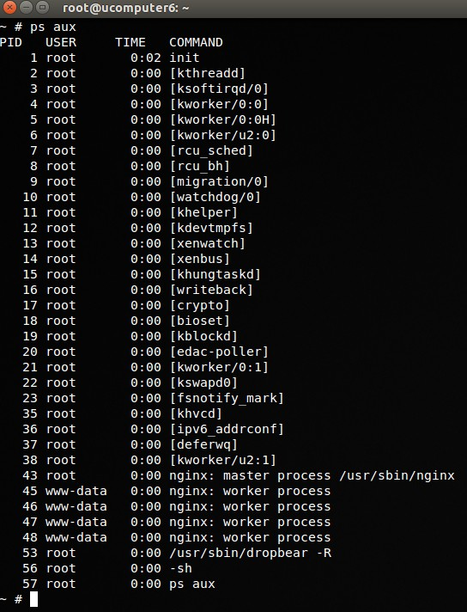
Tinyx: Taylor-made Distro
Nginx
User Applica5on
memcached
bash
3rd Party Applica5ons
libssl libc
Libraries
ssh init
Services
netfront
blkfront
ext4
Kernel

Slide 51

Tinyx: Taylor-made Distro
Nginx
User Applica5on
3rd Party Applica5ons
Libraries
Services
memcached
bash
libssl libc
ssh init
netfront
blkfront
ext4
Kernel

Slide 52

Tinyx: Taylor-made Distro
Nginx
User Applica5on
memcached
bash
3rd Party Applica5ons
libssl libc
Libraries
ssh init
Services
netfront
blkfront
ext4
Kernel

Slide 53
Tinyx: Taylor-made Distro
Nginx
▌Keep only the necessary bits and pieces
Specialized kernel build containing only the necessary modules
Root filesystem populated with only necessary services, libraries and 3rd party applications
User Applica5on
memcached
bash
3rd Party Applica5ons
libssl libc
Libraries
ssh init
Services
netfront
blkfront
ext4
Kernel

Slide 54
Virtualization Technologies
“Standard” VM
Standard Debian-based Linux VM
“Tinyﬁed” VM
Tinyx, based on Linux kernel/busybox
Unikernel
On Xen: MiniOS + miniperf
On KVM: OSv + iperf
Containers
Docker

Slide 55

Virtualization Technologies
“Standard” VM
Standard Debian-based Linux VM
“Tinyﬁed” VM
Tinyx, based on Linux kernel/busybox
Unikernel
On Xen: MiniOS + miniperf
On KVM: OSv + iperf
Containers
– Docker

Slide 56
What’s a Unikernel?
Specialized VM: single application + minimalistic OS
Single address space, co-operative scheduler so low overheads

Slide 57








What’s a Unikernel?
Specialized VM: single application + minimalistic OS
Single address space, co-operative scheduler so low overheads
app N
USER SPACE
app 1
app 2
KERNEL SPACE
driver1
driver2
driverN
GENERAL-PURPOSE OPERATING SYSTEM
(e.g., Linux, FreeBSD)

Slide 58





What’s a Unikernel?
Specialized VM: single application + minimalistic OS
Single address space, co-operative scheduler so low overheads
app N
USER SPACE
app 1
app 2
KERNEL SPACE
app
SINGLE ADDRESS SPACE
driver1
driver2
driverN
Vdriver1
vdriver2
GENERAL-PURPOSE OPERATING SYSTEM
(e.g., Linux, FreeBSD)
MINIMALISTIC OPERATING SYSTEM
(e.g., MiniOS, OSv)

Slide 59
Unikernels for Benchmarking
apps
guest OS
Xen
On Xen

Slide 60


Unikernels for Benchmarking
apps
guest OS
Xen
iperf
mini OS
Xen
On Xen

Slide 61
Unikernels for Benchmarking
apps
guest OS
Xen
iperf
mini OS
Xen
On Xen
apps
guest OS
KVM
On KVM

Slide 62

Unikernels for Benchmarking
apps
guest OS
Xen
iperf
mini OS
Xen
On Xen
apps
guest OS
KVM
iperf
OSv
KVM
On KVM

Slide 63
Nota Bene…
Our unikernel numbers include optimizations to the underlying virtualization platforms (Xen, KVM)
Toolstacks
Back-end stores
Hotplug scripts
Network drivers (on Xen Tx)
No time to go over these…

Slide 64
RESULTS

Slide 65



















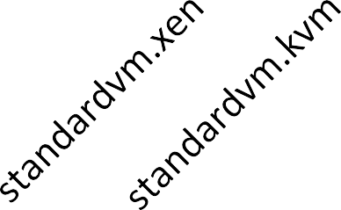
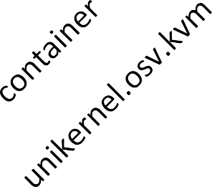
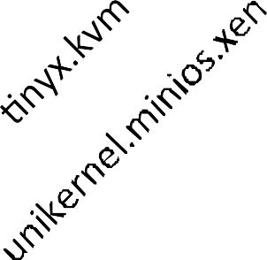
Image Size, Memory Usage (log scale)
1000
913 913
img size mem usage
100
112
82
MB
61
52
31
30
10
12
8
3.8
3.7
3.5
2
1

Slide 66














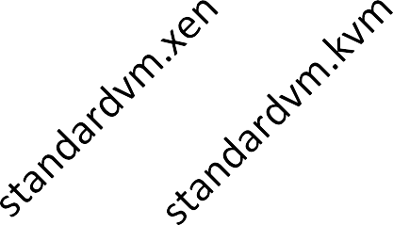
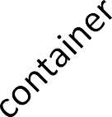
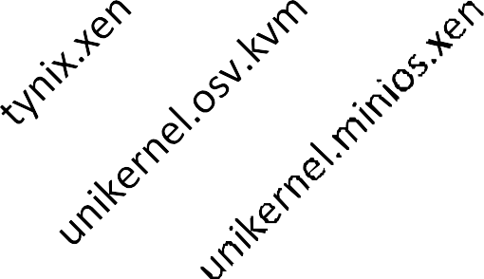
Boot Times (log scale)
10000
6500
2988
1000
1711
Boot Time (ms)
1081
431
330
100
31
10
1

Slide 67














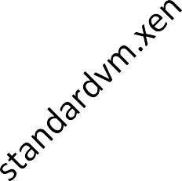
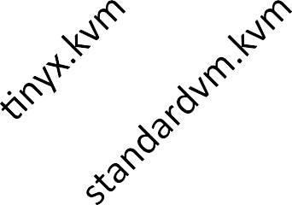
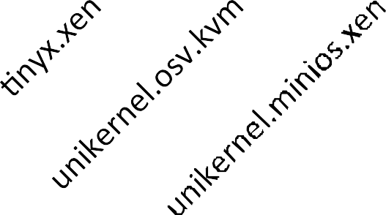

RTT
40
35
30
25
20
15
10
5
0
34
RTT (ms)
19
18
15
9
5
4

Slide 68






















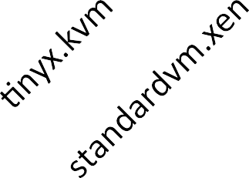
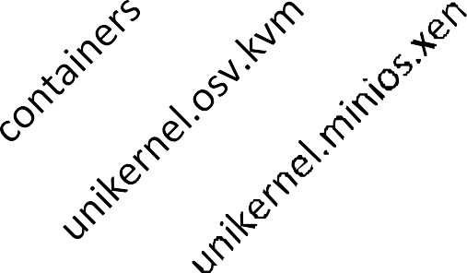
Throughput
60
Tx Rx
Throughput (Gb/s)
50
40
30
20
10
0

Slide 69
Conclusions
Common lore: VMs provide good isolation but are heavyweight
Results with standard VMs conﬁrm this
Containers provide lighter-weight virtualization
But Tinyﬁed VMs and especially unikernels yield comparable performance

Slide 70

Conclusions
Common lore: VMs provide good isolation but are heavyweight
Results with standard VMs conﬁrm this
Containers provide lighter-weight virtualization
But Tinyﬁed VMs and especially unikernels yield comparable performance

Slide 71
Potential Contributions to
draT-natarajan-nfvrg-containers-for-nfv-01
Challenges
VNF provisioning time
Runtime performance (throughput, scaling up/down)
Beneﬁts of Containers
Service agility vs VMs
Containers have better runtime performance
Auto-scaling of VNFs
Cross-VNF compatibility: container unikernel/minimalistic distro
Overall performance: VMs -25% throughput vs containers
5. Conclusion
- Containers have signiﬁcant advantages vs hypervisor-based solutions

